Slide 1

Arun Narayanan
2/12/2026
Dublin Bus Delays: Impacts and Insights
Guidance for Urban Planners and Transit Officials

Slide 2
2
1. Introduction and Data Collection
Analysis and Visualization of Delay Patterns
Implications, Limitations, and Recommendations
Agenda

Slide 3
Introduction and Data Collection
3

Slide 4
Understanding Dublin's Bus Delays
INTRODUCTION AND DATA COLLECTION
4
Bus Delays Are Not Uniform Across Dublin
Central Dublin maintains smoother ﬂow due to dedicated corridors
Data-Driven Insights for Urban Planning
1.5 million records reveal spatial and temporal delay patterns
West Dublin Faces Severe Rush Hour Delays
Morning (07:00–10:00) and evening (17:00–20:00) peaks see major congestion
Implications for Transit Policy
Targeted interventions can address regional bottlenecks

Slide 5

Project Approach and Data Sources
INTRODUCTION AND DATA COLLECTION
5
Extensive Data Collection
1.5 million records gathered over 13 days from NTA GTFS feeds
Integrated Real-Time & Static Sources
Combined live vehicle updates with static schedules for accuracy
Urban Focus: Greater Dublin Area
Filtered data to urban boundaries for relevant congestion analysis

Slide 6

INTRODUCTION AND DATA COLLECTION
6
Big Data Challenges and Solutions
Handled Massive Data Streams
Processed 1.5M+ records from real-time and static sources
Optimized Processing with Advanced Tools
Used Polars and Google Colab for fast, scalable data handling
Integrated Diverse Data Formats
Merged binary Protobuf streams with structured CSV schedules
Enabled Accurate Geospatial Mapping
Linked live delay data to physical bus routes for visualization

Slide 7
Analysis and Visualization of Delay Patterns
7

Slide 8
Key Findings: Delay Patterns
ANALYSIS AND VISUALIZATION OF DELAY PATTERNS
8
Rush Hour Delays Vary by Region
Delays are not evenly distributed across Dublin.
West Dublin Faces Severe Peak Delays
Morning and evening peaks see >10 min delays frequently.
Central Dublin Maintains Flow
Dedicated bus corridors help keep delays minimal.

Slide 9
Geographic Inequality in Delays
ANALYSIS AND VISUALIZATION OF DELAY PATTERNS
9
Delays Concentrated in West Dublin
Routes in West Dublin face frequent and severe delays.
Central Dublin Maintains Flow
Dedicated bus corridors help keep delays minimal in the city centre.
Regional Disparities Evident
North and Central routes experience fewer 'badly delayed' buses.
Implications for Equity
Commuters in affected areas face longer, less reliable journeys.

Slide 10
Visualizing the Problem
ANALYSIS AND VISUALIZATION OF DELAY PATTERNS
10
Animated Map Reveals Delay Patterns
Dynamic visualization shows how delays build up across the city.
Color-Coding Pinpoints Hotspots
Routes are shaded by severity, making problem areas instantly visible.
3D Context Enhances Urban Insight
Extruded buildings help planners orient and relate delays to landmarks.
Time Slider Enables Cycle Exploration
Users can interactively explore delays throughout the day.

Slide 11
Design Choices for Clarity
ANALYSIS AND VISUALIZATION OF DELAY PATTERNS
11
Dark Mode Map for Visual Focus
Reduces background noise, making data points stand out
Intuitive Traffic Light Color Scale
Green to red gradient instantly signals delay severity
Interactive, User-Driven Exploration
Clickable stops and region filters reveal granular delay details

Slide 12
Implications, Limitations, and Recommendations
12

Slide 13
Implications for Urban Planning
IMPLICATIONS, LIMITATIONS, AND RECOMMENDATIONS
13
Focus on High-Delay Corridors
West Dublin routes experience the most severe delays.
Strategic Infrastructure Investment
Enhancing bus corridors in bottleneck areas can ease congestion.
Leverage Data for Equitable Planning
Use delay analytics to prioritize improvements where needed most.
Improve Network Efficiency
Targeted actions can reduce overall travel times and boost reliability.

Slide 14
Technical Limitations and Next Steps
IMPLICATIONS, LIMITATIONS, AND RECOMMENDATIONS
14
Managing Visual Overload
Area-based filtering prevents map chaos from all-route rendering.
Advancing Real-Time Capabilities
Integrating live data streams will enhance responsiveness.
Addressing Data Gaps
Improved handling of missing or inactive bus data is needed.
Ongoing Data Collection
Continuous data gathering will sharpen delay insights over time.

Slide 15
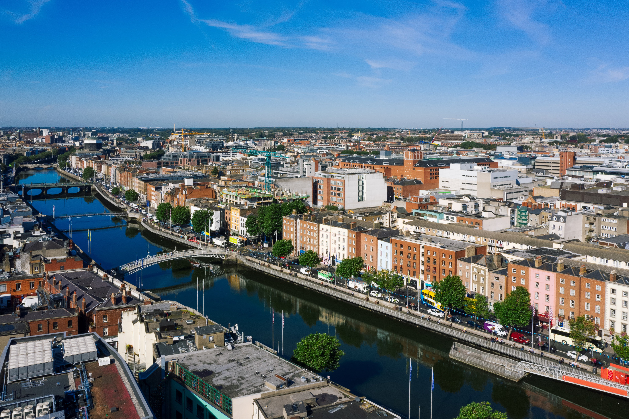
IMPLICATIONS, LIMITATIONS, AND RECOMMENDATIONS
15
Key Takeaways for Decision Makers
Delays Concentrated in Specific Areas
West Dublin faces severe rush hour delays; central routes remain resilient.
Visual Data Pinpoints Hotspots
Animated maps reveal when and where delays peak across the city.
Targeted Solutions Drive Equity
Strategic interventions can reduce delay disparities and improve service reliability.

